Slide 1
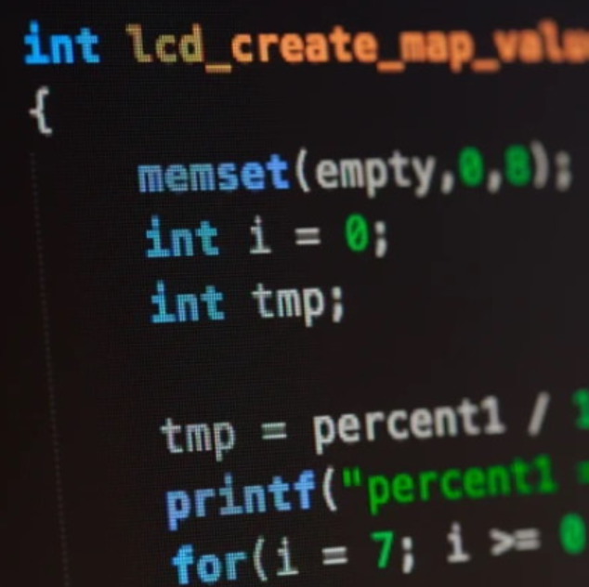
CIS 161
Dr. Patton
Module 1

Slide 2
Course Description
This course introduces you to C++ functional programming and how to use an IDE (Integrated Development Environment). It will engage students in the exploration of functional programming in C++ to program, test, and debug efficiently with a pragmatic approach. A variety of topics such as data types, control flow, function, stream input/output, coding tips, good practices, and more will be covered. There will be hands-on programming practices with covered topics.

Slide 3
Due Dates
Sundays 11:59PM CST
Participation
Attend scheduled class Meetings or Review Recordings

Slide 4

Textbooks & Materials
Required Textbooks & ISBN: Zybooks, ISBN: 9798203974549,
Zybooks code: DMACCCIS161Fall2023
Required Materials: Internet access outside of class
Optional or Recommended Books/Materials: Starting Out with Visual C#, Gaddis, 4th edition, 2016, Pearson Education. ISBN: 978013438260

Slide 5

Introduction to Programming

Slide 6
Algorithms
An algorithm is a simply step-by-step outline of how to execute a task. If you have ever baked a cake, pie, or cookies, or followed a recipe to make a special entrée for family or friends, you have experienced a real-world example of an algorithm.

Slide 7
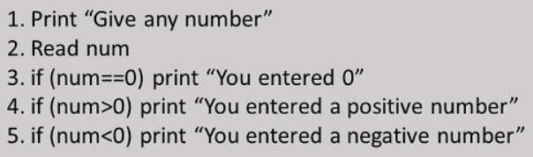
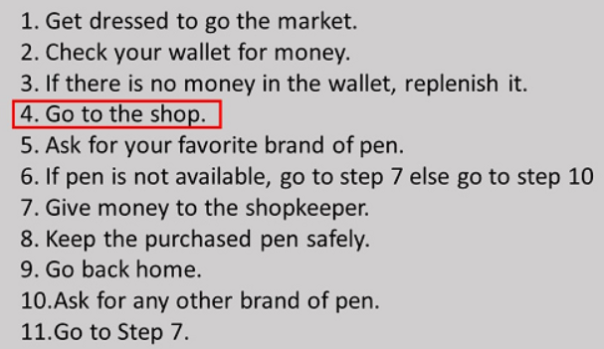
Algorithm examples
Programming Example
Real World Example

Slide 8
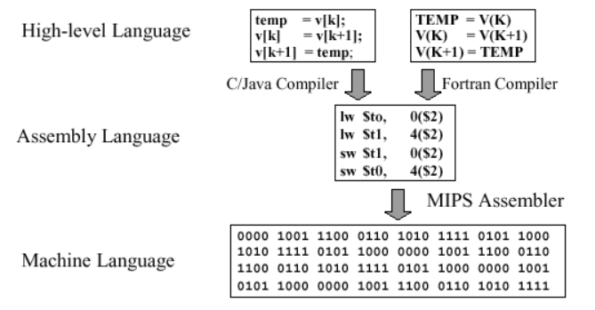

Slide 9
Computer software is written mostly in high-level languages like Java, C++, and Python. The collection of instructions written in a programming language is called source code. Source code cannot be directly executed by the computer. Rather, source code requires a language processor, which is a special-purpose system software used to translate the source code into machine code.

Slide 10
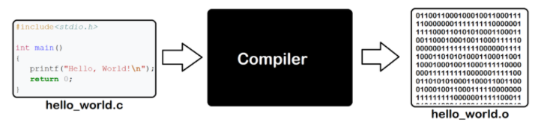
Compilers
A compiler translates source code into machine language. A compiler checks source code for errors before translating it into object code. If the source code is found to have errors, the compiler specifies the errors.

Slide 11





Programming Language examples

Slide 12
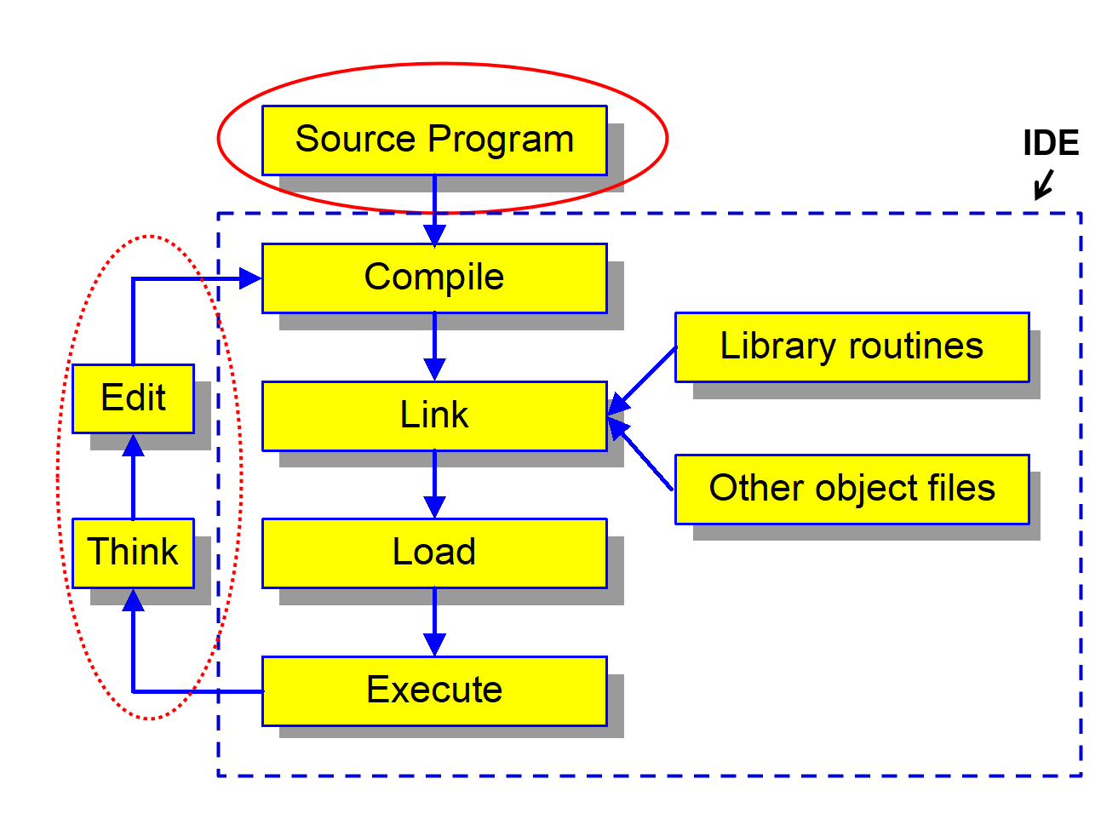
C++ Execution Process

Slide 13
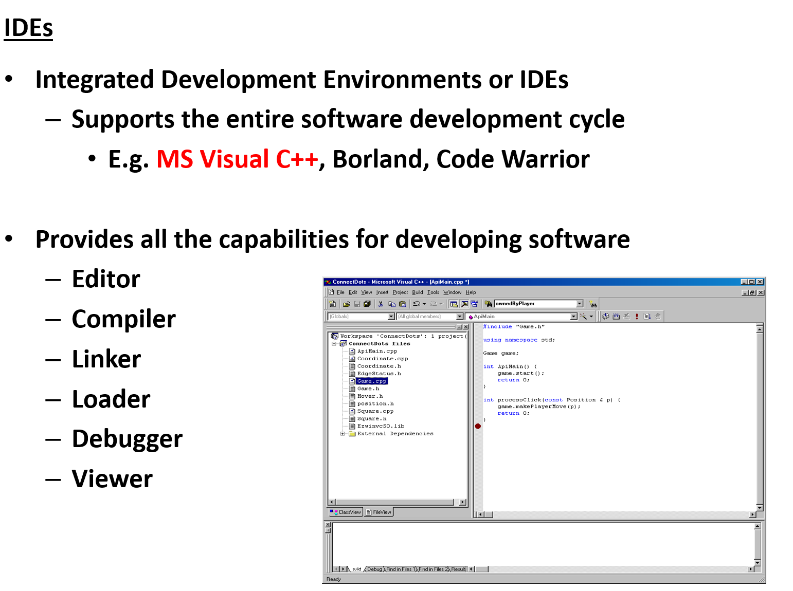

Slide 14
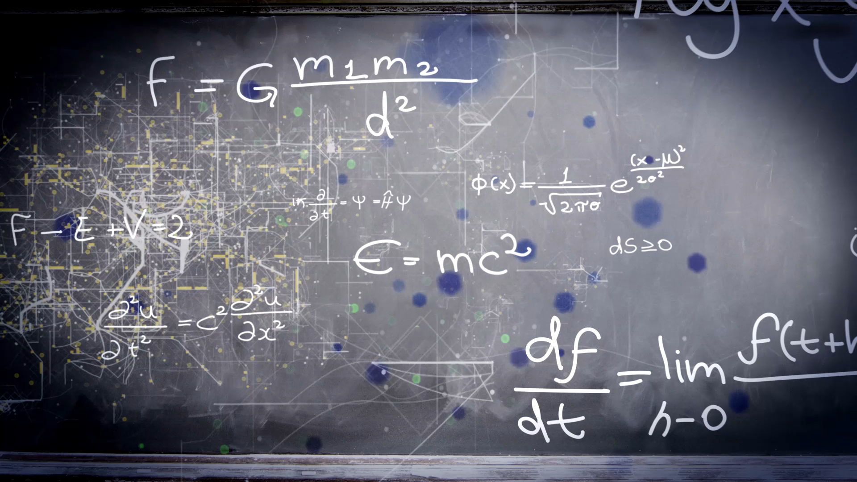
Programming in Practice

Slide 15
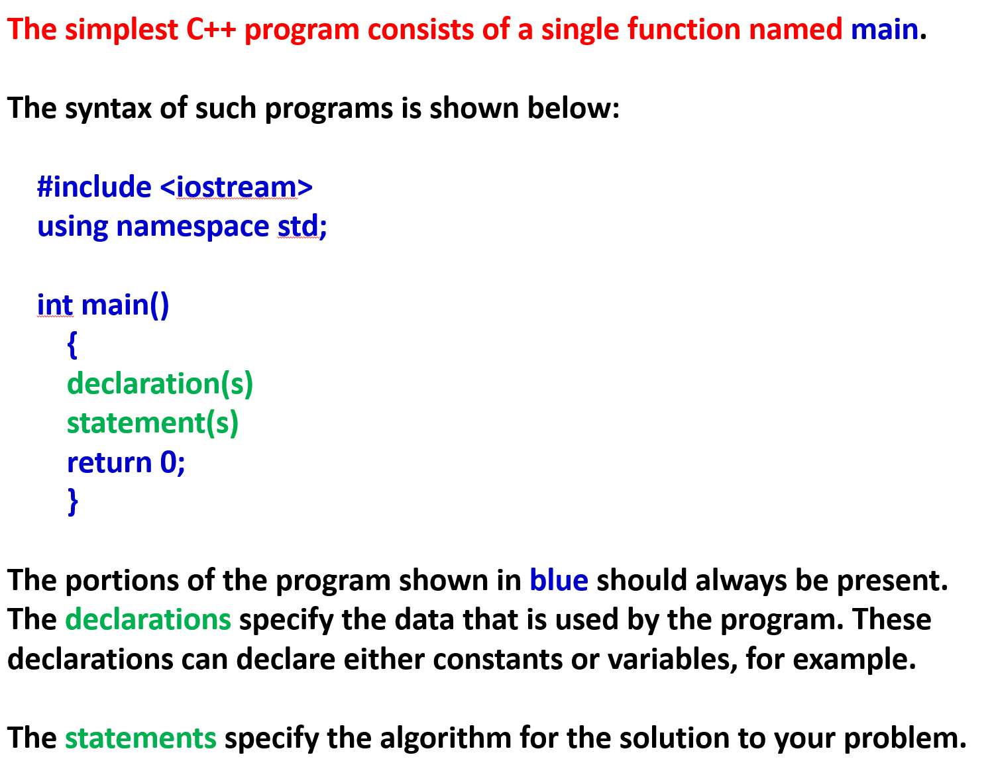

Slide 16
Statements and single-line comments
#include <iostream> // a preprocessor directive, not a statement
using namespace std;
int main()
{
cout << "Welcome to the Calorie Calculator\n\n";
// get number of servings from user
double servings;
cout << "Enter servings per food item: ";
cin >> servings;
// get number of calories from user
double calories;
cout << "Enter calories per serving: ";
cin >> calories;
// calculate total calories
double total_calories = servings * calories;
// display total calories
cout << "Total calories: " << total_calories << endl << endl;
return 0; // return a value indicating normal exit
}

Slide 17
A block comment
/*
* Author: M. Delamater
* Purpose: This program uses the console to get servings and calories from
* the user. It then calculates and displays the total calories.
*/

Slide 18
A main() function with no parameters
int main()
{
// statements
return 0;
}
A main() function with two parameters
int main(int argc, char** argv)
{
// statements
return 0;
}
A main() function with different brace placement
int main() {
// statements
return EXIT_SUCCESS;
}

Slide 19
Valid identifiers
subtotal i TITLE
subtotal x TAX_RATE
SubTotal item1
sub_total item2
_sub_total June2011
The rules for naming an identifier
Start each identifier with an upper- or lowercase letter or underscore.
Use letters, underscores, or digits for subsequent characters.
Don’t use C++ or C keywords.

Slide 20
C++ keywords (part 1)
alignas const import
alignof constexpr inline
and const_cast int
and_eq continue long
asm decltype module
atomic_cancel default mutable
atomic_commit delete namespace
atomic_noexcept do new
auto double noexcept
bitand dynamic_cast not
bitor else not_eq
bool enum nullptr
break explicit operator
case export or
catch extern or_eq
char false private
char16_t float protected
char32_t for public
class friend register
compl goto reinterpret_cast
concept if requires

Slide 21
C++ keywords (part 2)
return template unsigned
short this using
signed thread_local virtual
sizeof throw void
static true volatile
static_assert try wchar_t
static_cast typedef while
struct typeid xor
switch typename xor_eq
synchronized union

Slide 22
Additional C keywords
_Alignas _Imaginary
_Alignof _Noreturn
_Atomic _Static_assert
_Bool _Thread_local
_Complex restrict
_Generic

Slide 23
Two built-in data types for working with numbers
int
double

Slide 24
How to define and initialize a variable in two statements
Syntax
type variable_name;
variable_name = value;
Example
int counter; // definition statement
counter = 1; // assignment statement

Slide 25
How to define and initialize a variable in one statement
Syntax
type variable_name = value;
Examples
int counter = 1; // define and initialize
// an int variable
double unit_price = 14.95; // define and initialize
// a double variable

Slide 26
An example that uses assignment statements
int quantity = 0; // define and initialize
// an int variable
int max_quantity = 100; // define and initialize
// another int variable
// two assignment statements
quantity = 10; // quantity is now 10
quantity = max_quantity; // quantity is now 100

Slide 27

Naming recommendations for variables
Each variable name should be a noun or a noun preceded by one or more adjectives.
Try to use meaningful names that are easy to remember.
Use lowercase letters and separate the words with underscores (_).

Slide 28
Five arithmetic operators
Operator Name
+ Addition
- Subtraction
* Multiplication
/ Division
% Modulus

Slide 29
Statements with simple arithmetic expressions
// integer arithmetic
int x = 14;
int y = 8;
int result1 = x + y; // result1 = 22
int result2 = x - y; // result2 = 6
int result3 = x * y; // result3 = 112
int result4 = x / y; // result4 = 1
int result5 = x % y; // result5 = 6
// decimal arithmetic
double a = 8.5;
double b = 3.4;
double result6 = a + b; // result6 = 11.9
double result7 = a - b; // result7 = 5.1
double result8 = a * b; // result8 = 28.9
double result9 = a / b; // result9 = 2.5

Slide 30
Statements that increment a counter variable
int counter = 0;
counter = counter + 1; // counter = 1
counter = counter + 1; // counter = 2
Statements that mix int and double variables
double total = 251.0;
double result10 = total / counter; // result10 = 125.5
int result11 = total / counter; // result11 = 125
A statement that divides an integer by an integer
double result12 = x / y; // result12 = 1.0 (not 1.75)

Slide 31
Common header files of the C++ standard library
cstdlib
iostream
iomanip
cmath
string
vector
URL for a complete list of C++ header files
http://en.cppreference.com/w/cpp/header

Slide 32
Two objects available from the iostream header
cout
endl
How to send a message to the console
cout << "Hello!";
The console
Hello!

Slide 33
A simple program using directive for the std namespace
#include <iostream>
#include <cmath>
using namespace std; // use all elements of the std namespace
int main() {
int num = 7;
double root = sqrt(num);
root = round(root * 1000) / 1000; // round to 3 decimal places
cout << "The square root of " << num << " is " << root << endl;
}

